Slide 1
Managing Hair and Skin Side Effects of Lithium
David N. Osser, M.D.
Bipolar Telemedicine Consultation Service,
National Telemental Health Center at VA New England;
Associate Professor of Psychiatry,
Harvard Medical School
Notes:
So in video 5, we have the subject of managing hair and skin side effects, one of those sets of side effects that can be so unacceptable that patients will want to reject lithium forever and want you to try everything else you've got before they'd be willing to even think about reconsidering it.

Slide 2
Hair Loss
Affects up to 10% of patients
More in women
Maintain TSH
≤ 2 mIU/L; treat with thyroxine
Rule out thyroid dysfunction
Grootens, K. P., & Hartong, E. G. (2017). A Case Report of Biotin Treatment for Valproate-Induced Hair Loss. The Journal of clinical psychiatry, 78(7), e838-e838.
Carroll, J. A., Jefferson, J. W., & Greist, J. H. (1987). Psychiatric uses of lithium for children and adolescents. Psychiatric Services, 38(9), 927-928.
Notes:
So let's start with hair loss. And hair loss may affect up to 10% of people who take lithium. Interestingly though, in a comparison with valproate, valproate caused hair loss in 12%. So yes, this could happen. It's more common in women. Maybe there's a lower rate probably, not clear but we don't have good head-to-head data but carbamazepine may have lower hair loss rates. So what to do? First of all, rule out low thyroid. That is one of the causes of hair dropping out. This is a long-term side effect. I had discussed in previous videos how you need to monitor thyroid function every six months and we should be keeping TSHs according to the very latest thinking, lower than we used to think we should keep them, maybe even at 2 or less with the TSH, certainly no higher than 5. And treating with thyroxine. And sooner rather than later before side effects like hair loss occur and the other side effects like weight gain.
*References*
Grootens, K. P., & Hartong, E. G. (2017). A Case Report of Biotin Treatment for Valproate-Induced Hair Loss. The Journal of clinical psychiatry, 78(7), e838-e838.
Carroll, J. A., Jefferson, J. W., & Greist, J. H. (1987). Psychiatric uses of lithium for children and adolescents. Psychiatric Services, 38(9), 927-928.

Slide 3
Hair Loss Mechanism
Mechanism
Comment
Biotin deficiency
Occurs with valproate
Zinc and selenium malabsorption
Occurs with lithium and valproate
Suggested supplementation (?)
Grootens, K. P., & Hartong, E. G. (2017). A Case Report of Biotin Treatment for Valproate-Induced Hair Loss. The Journal of clinical psychiatry, 78(7), e838-e838.
Notes:
Some think that the mechanisms are different for what causes the hair loss and it's been proposed that there's a biotin deficiency in valproate.
Whereas, with lithium, it may be that there are minerals, zinc and selenium that are involved in hair growth and those maybe have their absorption affected. Actually, valproate could do that too with those minerals. So these are the possible mechanisms.
*References*
Grootens, K. P., & Hartong, E. G. (2017). A Case Report of Biotin Treatment for Valproate-Induced Hair Loss. The Journal of clinical psychiatry, 78(7), e838-e838.

Slide 4
Hair Loss Treatment
Supplement with
zinc 50 mg/day and selenium 200 mg/day
Maintain lithium at optimal range (0.6 mEq/L to 0.75 mEq/L)
Discuss risk–benefit analysis with the patient
Minoxidil (Rogaine)
Grootens, K. P., & Hartong, E. G. (2017). A Case Report of Biotin Treatment for Valproate-Induced Hair Loss. The Journal of clinical psychiatry, 78(7), e838-e838.
Notes:
And that has led to a proposal that we could give supplemental zinc and selenium. It's been proposed that you give 50 mg of zinc, 200 mg of selenium. These are typical amounts that you'll find in a vitamin supplement with minerals but they could be given separately as well once daily. Now, I looked up the literature. I couldn't find any reports that this actually has been demonstrated to work. This is purely speculative based on ideas about mechanism. It's not clear that they'll help but it is something you could try.
Next thing you could try is or certainly if not before trying it, you should perhaps first be sure that the lithium levels are in the optimal therapeutic range, 0.6 to 0.75 so you're at least minimizing any excess lithium that could be in the picture
And finally, the last suggestion also obtained from Jefferson's Lithium Encyclopedia for Clinical Practice, 1987 edition, So they have case reports of trying minoxidil known by its brand name Rogaine. Now, the package insert actually for Rogaine says you can't use it for hair loss from drugs.
So those are your options for dealing with the hair loss.
But indeed, this is a tough side effect psychologically for people. What can you do? It is really worth -- I mean, hair loss is a cosmetically very unpleasant thing. But bipolar disorder is doing very often a lot of very, very unpleasant things to a person's life. If it's bipolar I, we're talking about severe impairment of social or occupational functioning, severe. That's one of the criteria for bipolar I. So if they're having that and the option is continuing to have that versus this hair loss, some people might just choose to have the improvement from the lithium. This is the kind of discussion you need to have about it. Now, you could go on to try the other treatments and it may be reasonable to do that. The patient may insist on that but they should know that these other treatments are pretty much demonstrably less effective across the board for many aspects of bipolar disorder. So this is the risk-benefit analysis that needs to be made explicit with patients over the issue of hair loss.
*References*
Grootens, K. P., & Hartong, E. G. (2017). A Case Report of Biotin Treatment for Valproate-Induced Hair Loss. The Journal of clinical psychiatry, 78(7), e838-e838.

Slide 5
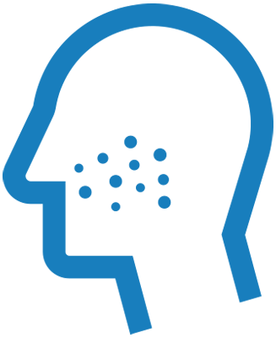
Acne
Acne may get worse: Refer for conventional treatment
Maintain levels of lithium at 0.6 mEq/L to 0.75 mEq/L
Gupta, A. K., Knowles, S. R., Gupta, M. A., Jaunkalns, R., & Shear, N. H. (1995). Lithium therapy associated with hidradenitis suppurativa: case report and a review of the dermatologic side effects of lithium. Journal of the American Academy of Dermatology, 32(2), 382-386.
Notes:
Now, rashes, skin issues are another area of problem with lithium. Acne can get worse and this may affect adherence. Spontaneous improvement does occur sometimes in cases that they've followed. You may, if you haven't already, refer them for conventional treatment of their acne. Tetracycline, for example, can be used with lithium for this indication. The level of lithium may make a difference. It might be that if they're at a higher level and you lower them to the recommended 0.6 to 0.75 level, that might reduce the impact of this symptom.
*References*
Gupta, A. K., Knowles, S. R., Gupta, M. A., Jaunkalns, R., & Shear, N. H. (1995). Lithium therapy associated with hidradenitis suppurativa: case report and a review of the dermatologic side effects of lithium. Journal of the American Academy of Dermatology, 32(2), 382-386.

Slide 6
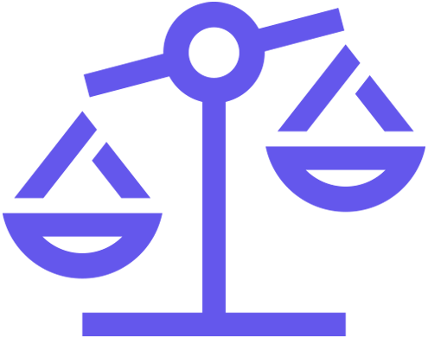
Psoriasis
Psoriasis occurs in up to 6% of patients
Assess risk–benefit with dermatologist and patient
Other rashes: Atopic dermatitis
Gupta, A. K., Knowles, S. R., Gupta, M. A., Jaunkalns, R., & Shear, N. H. (1995). Lithium therapy associated with hidradenitis suppurativa: case report and a review of the dermatologic side effects of lithium. Journal of the American Academy of Dermatology, 32(2), 382-386.
Notes:
Now, another kind of rash is psoriasis. And exacerbations and breakthroughs do occur and it could be related to lithium's effect to demarginalize neutrophils. Psoriasis has been reported to occur in up to 6% of patients treated with lithium. So of course, you would refer them for conventional treatment if they're new cases. And I would certainly discuss if there's any question whether it's advisable to try lithium in an ongoing patient with psoriasis to discuss with the person who's treating the psoriasis the advisability of lithium, the management options and to try to assess the risk-benefit ratio on a case-by-case basis. But if the problem resists conventional treatment, lithium may have to be stopped.
There are other rashes as well that you can get with lithium. Atopic dermatitis can occur. My references again for this discussion of rashes is from the discussion in Jefferson's Lithium Encyclopedia, 1987.
*References*
Gupta, A. K., Knowles, S. R., Gupta, M. A., Jaunkalns, R., & Shear, N. H. (1995). Lithium therapy associated with hidradenitis suppurativa: case report and a review of the dermatologic side effects of lithium. Journal of the American Academy of Dermatology, 32(2), 382-386.

Slide 7
Key Points
Hair loss may occur in 10% of patients treated with lithium.
Reducing lithium levels to 0.75 mEq/L and correcting thyroid dysfunction may help to prevent hair loss.
Consider supplementing with zinc and selenium to treat hair loss.
Notes:
So in summary for this video on skin and rash problems, hair loss may occur in 10% of patients on lithium though it's 12% with valproate. It may help to reduce any doses that are over 0.75 mEq/L as the blood level being achieved with those doses. That may help. It may help to correct thyroid dysfunction. And it may help to consider adding zinc and selenium present in multivitamins although this has no evidence base other than speculations based on possible mechanisms.

Slide 8
Key Points
Psoriasis can be initiated or worsened by lithium. Clinicians must take patient history and consult with a dermatologist to assess risk and treatment options.
Other rashes and acne may occur due to treatment with lithium, causing difficulty in treatment adherence.
Notes:
Second bullet point is about psoriasis and skin issues. Psoriasis can be initiated or made worse by lithium. Definitely, take a history and be aware if the patient has it. And if so, consult with the psoriasis care provider on the risks and the monitoring and additional treatment that might be needed. It might require you to stop or not use lithium. And other rashes are common including exacerbation of acne. Adherence may be affected. Consult with their primary care treater on strategies for these rashes and for acne.

Slide 9
Next Presentation Tremor and Neurological Side Effects of Lithium

